Slide 1
Probabilistic Learning
Gaussian Mixture Models and Expectation Maximisation

Slide 2
Contents:
Gaussian Mixture Model Introduction
EM algorithm for 2 classes
General EM algorithm.

Slide 3
Gaussian Mixture Models
An unsupervised classification algorithm.
We do not know the labels for each class, nor how many classes there are.
However the data has many modes (each mode can be thought of as a class that is a Gaussian Distribution).
So we fit one Gaussian distribution per class. So if we have m modes, we have m Gaussian distributions.

Slide 4
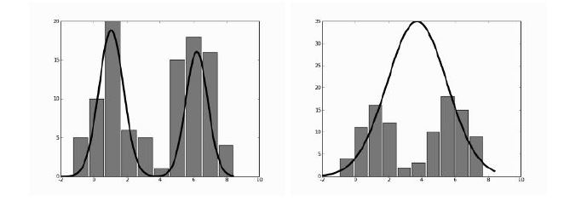
Gaussian Mixture Models
The histogram here shows our data has 2 modes, hence fitting 2 distributions (left) is more natural than one (right).

Slide 5
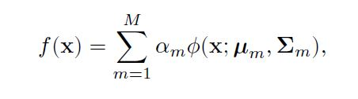
How do we characterize Gaussians?
A Gaussian distribution has a mean and a covariance matrix. Once we find these 2 values, we no longer need the data points that we originally calculated them with.
Each class is weighted by a weight alpha.
So, for each of the m classes, we have to find the mean and covariance matrix. Once we do that, we can tell the overall expected value of a data point x considering all classes:

Slide 6
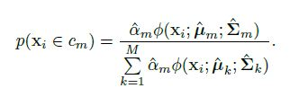
How to infer on unseen data?
Once we figure out the mean and covariance for each class (mode), given an unseen data point x, how do we tell which mode/class it belongs to?
We do this by seeing seeing the relative weight of each class over the overall expected value we saw previously.
So, the term which contributes the most to the sum will have the highest value and hence the point x would belong to that class.
This formula here tells us the probability of a data point x belonging to class m, we calculate this over all classes and choose the class with the max value.

Slide 7
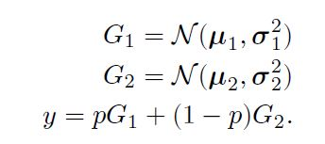
How do we choose the weights alpha?
The goal now is not only to calculate the mean and covariance for each class, but also get the values for the weights (alpha) of each class. Note that the sum of the weights over all classes is 1.
How can we do this? Consider data with 2 modes as gaussian distributions G1 and G2, characterised by their means and covariances.
We don’t know which gaussian each point is from, let us assume that probability that a point is from G1 is p (and G2 would naturally be 1 - p ).
Thus our output y would be weighted by this probability p and 1 - p of our G1 and G2 output:

Slide 8
How do we choose the weights alpha?
Writing this as a proper probability density P, with distribution of p being π, we get:
Now, we can find the optimum value of pi, mean and standard deviation by taking the log of this term for all training examples separately and find the mean value.
Then we can go ahead and differentiate this with respect to each parameter.
This is however a very hard process.
Another simpler method exists: Expectation Maximisation.

Slide 9
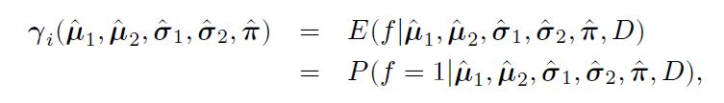
EM algorithm: E - term
We assume a latent/hidden variable f, f = 0 means data came from G1, f = 1 means data came from G2.
We don’t know anything about f, however given the means, S.D and pi value and a data point D, we can calculate what is the the probability/expectation of f being 1. Let this be called gamma (which is a value for each data point i)

Slide 10
EM algorithm: M - step
Now that we have the E - term, we update the 2 means, S.D and pi to maximise the E - term.
This is called the maximisation or M step.
We iteratively apply these 2 steps till the E value converges to its maximum and does not change.
This is where we get the name expectation maximisation.

Slide 11
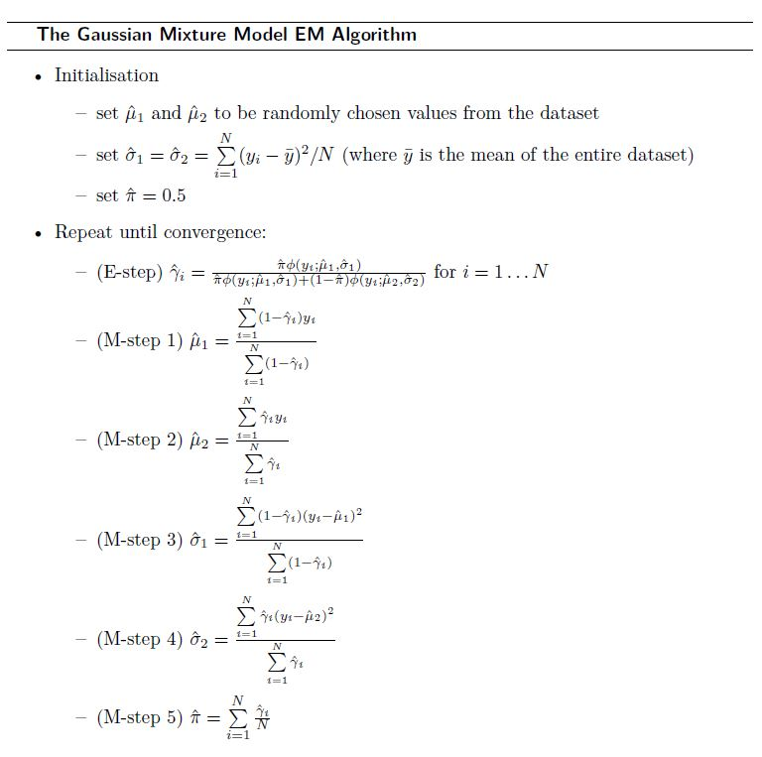
A full 2 class EM algorithm:
The initial values for the 2 means are randomly chosen points in the dataset.
The initial values for the 2 S.Ds are set to the same value (S.D of the whole dataset)
We initially assume that pi is 0.5 (equal chance of a data point being from both classes).
The M step updates are all functions of the gamma values computed in the E-step.

Slide 12
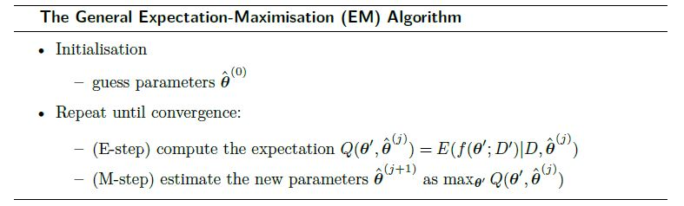
The Generalised EM Algorithm:
We define how the latent variables are taken, and how we optimise them, this leads to a much more abstracted algorithm as follows:

Slide 13
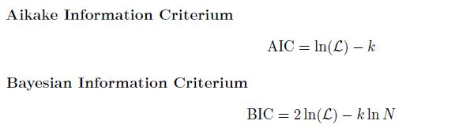
Information Criteria (not directly related to EM):
Given a model, how can we tell it is doing good on the data without cross validation?
We can calculate 2 different criteria (AIC and BIC), which tell how good a model with k parameters is doing given the best likelihood L it can produce after training with N data points.
The model with the largest value of these criteria are chosen as the best models.

Slide 14
Thank you!
Next topic: Nearest Neighbour Methods

